Slide 1
Machine and Deep Learning-Based Drought Prediction in Northwestern Iran Using the Standardized Precipitation Index

Slide 2
Literature Review

Slide 3
Application of artificial intelligence hybrid models for meteorological drought prediction 2022
This article investigates the use of hybrid artificial intelligence models to predict meteorological droughts using the Standardized Precipitation Evapotranspiration Index (SPEI) in northwestern Iran. It focuses on integrating wavelet transformation with advanced AI techniques to enhance forecasting accuracy over 1-, 6-, and 12-month time scales.
Purpose: Improve drought prediction methods and reduce associated risks.
Key Indicator: SPEI used as the main drought index.
Study Area: Northwestern Iran (Ardebil Province).
AI Models Evaluated: MLPNN, SVR, ANFIS, EDT.

Slide 4
Application of artificial intelligence hybrid models for meteorological drought prediction
The study designs a hybrid modeling framework that leverages data preprocessing techniques, such as wavelet transformation, to tackle non-stationary time series data. It explores different combinations of input parameters—including precipitation, temperature, and historical drought indices—using statistical tools to identify optimal lags before applying AI models.

Slide 5
Application of artificial intelligence hybrid models for meteorological drought prediction
Input Data Processing:
Data normalization via Feature Scaling.
Use of ACF and PACF to determine significant lags.
Effective Factor Elimination Technique (EFET) to select optimal input parameters.
Hybrid Modeling:
Integrates wavelet transformation (DWT) to extract trends and reduce data noise.
Compares both single parameter (drought index alone) and multiparameter models.
AI Techniques Applied:
Multilayer Perceptron Neural Network (MLPNN) with wavelet transformation.
Support Vector Regression (SVR), Adaptive Neuro-Fuzzy Inference System (ANFIS), and Ensemble Decision Tree (EDT).

Slide 6
Application of artificial intelligence hybrid models for meteorological drought prediction
The study finds that model performance improves when the input data are carefully selected and preprocessed. Specifically, for short time scales, using the drought index alone with a wavelet-enhanced MLPNN yields superior predictions, while for longer time scales, combining multiple parameters with a wavelet-enhanced SVR delivers the best performance. These results are validated using statistical metrics such as RMSE, Correlation Coefficient (CC), and Nash–Sutcliffe Efficiency (NSE).

Slide 7
Application of artificial intelligence hybrid models for meteorological drought prediction
Performance Metrics:
RMSE, CC, and NSE used to evaluate each model's accuracy.
Key Outcomes:
1- & 6-Month Forecasts: Drought index-only inputs with wavelet-MLPNN perform best.
12-Month Forecast: Multiparameter inputs (drought index, precipitation, temperature) with wavelet-SVR offer highest reliability.
Implications:
Hybrid modeling notably enhances prediction skill, with implications for planning and mitigating drought impacts.

Slide 8
Proposal Flowchart

Slide 9
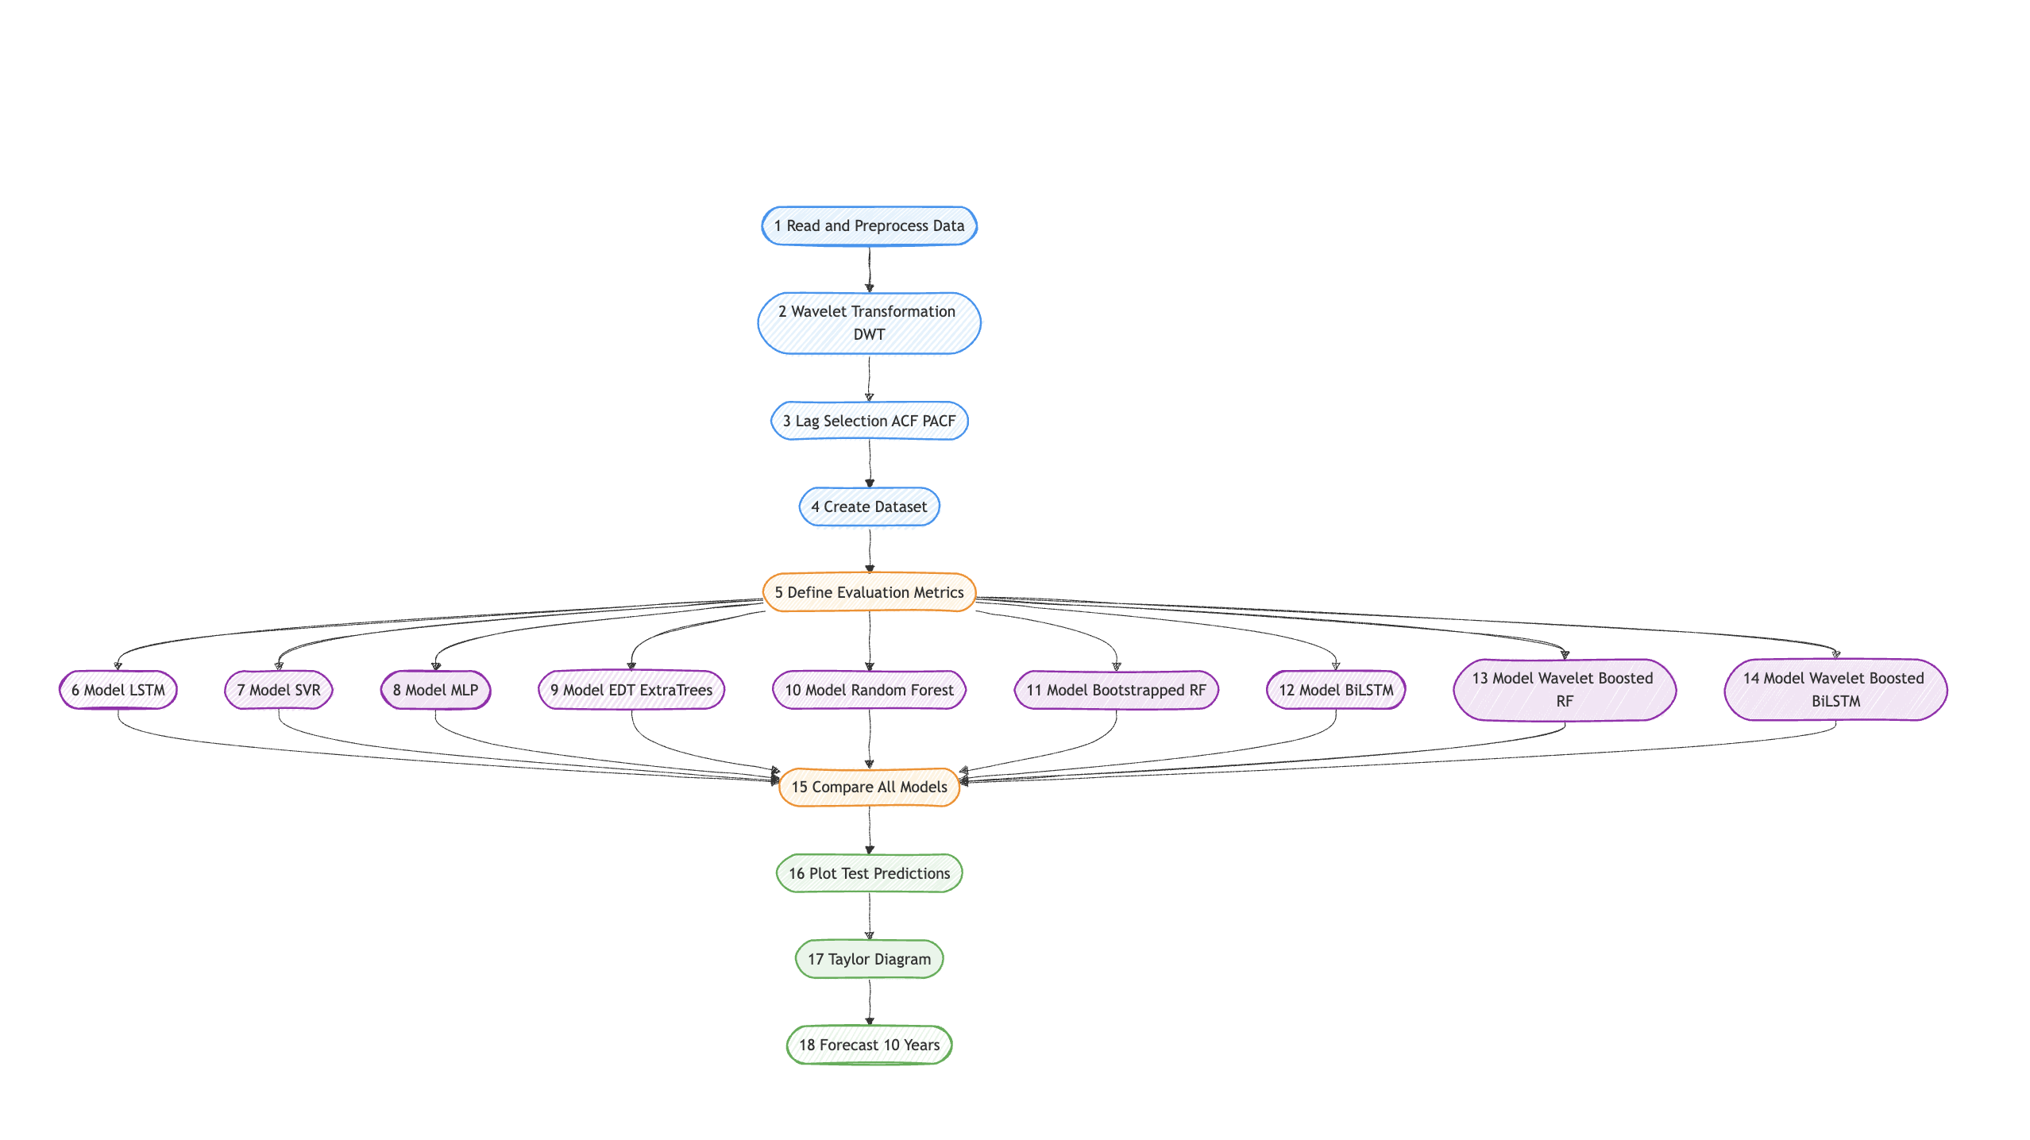

Slide 10
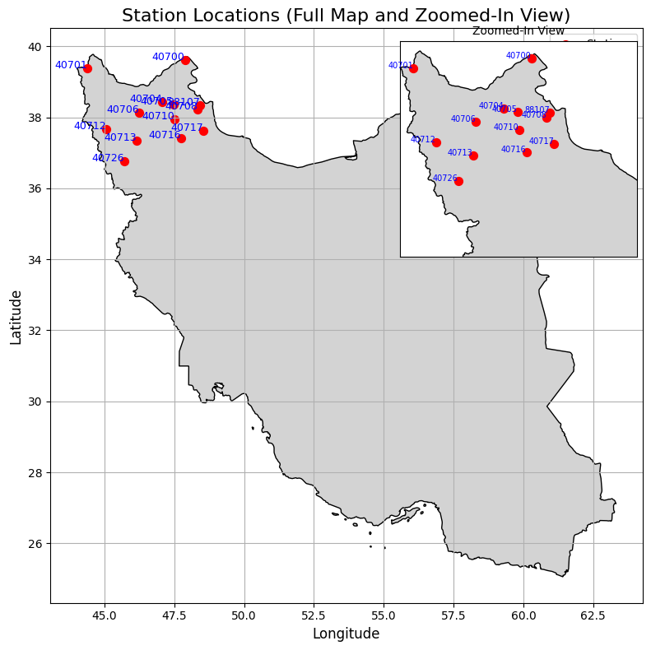
Station Distribution

Slide 11
Dataset definition

Slide 12
Structure of Dataset
Dataset Overview
Time Range: Jan 1, 1990 — Apr 1, 2024
Stations: 7 meteorological stations
Category | Features
Station Info | station_id, station_name, region_id, region_name, lat, lon, station_elevation
Temperature | tmax_m, tmax_max, tmax_min, tmin_m, tmin_min, tmin_max, ntmin_0
Rainfall & Snow | rrr24 (24-hr rainfall) , sshn (snow height)
Daily Averages | tm_m (mean temp), t_03_m, t_09_m, t_15_m (temps at 3h, 9h, 15h)

Slide 13
relevant columns
rrr24: likely precipitation (24-hour rainfall in mm)
tmax_, tmin_, tm_m, etc.: temperature indicators
sshn: possibly snow height
lat, lon, station_id

Slide 14
Common drought indicators
SPI (Standardized Precipitation Index) – based only on precipitation.
SPEI (Standardized Precipitation Evapotranspiration Index) – considers both precipitation and temperature.

Slide 15
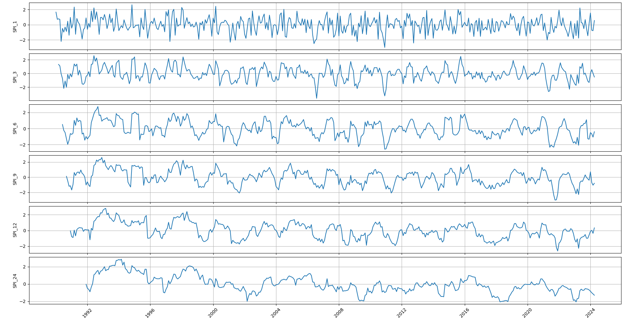
Standardized Precipitation Index (SPI) Analysis (1992–2024)

Slide 16
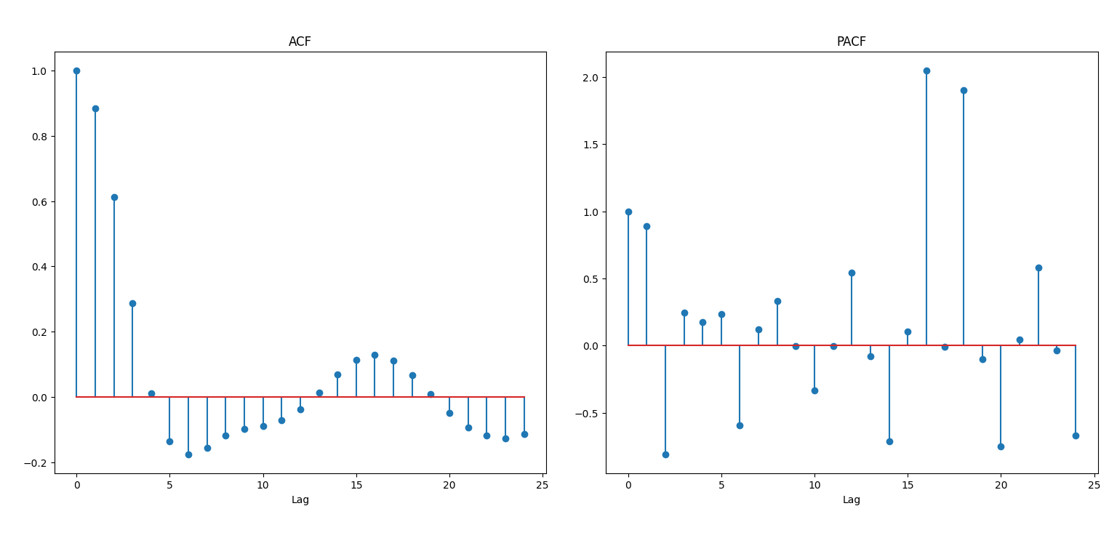
ACF and PACF

Slide 17
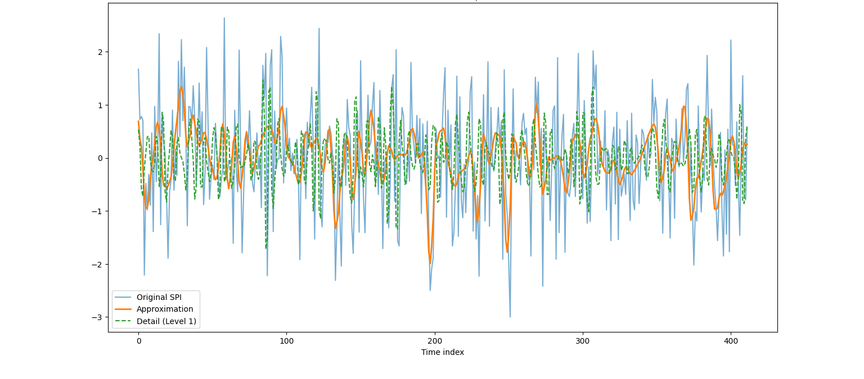
SPI with Wavelet Components

Slide 18
Model Comparison for SPI Prediction
Models Compared
LSTM : Long Short-Term Memory network
MLP : Multi-Layer Perceptron
RF: Random Forest
Bi-LSTM : Bidirectional LSTM
WBi-LSTM : Weighted/Wavelet Bidirectional LSTM
SVR : Support Vector Regression
EDT : Extremely Randomized Trees
BRF : Boosted Random Forest
WBRF : Weighted Boosted Random Forest

Slide 19
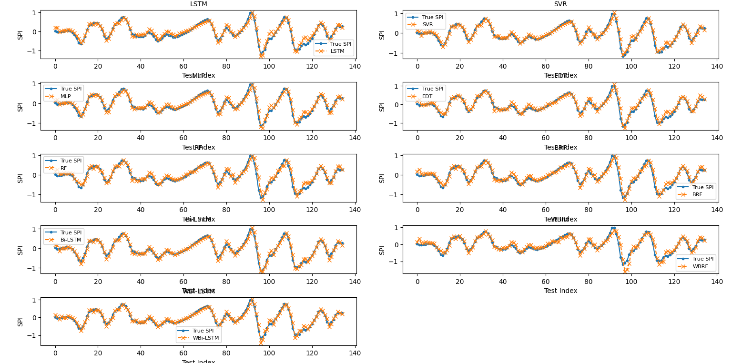
Model Comparison for SPI Prediction

Slide 20
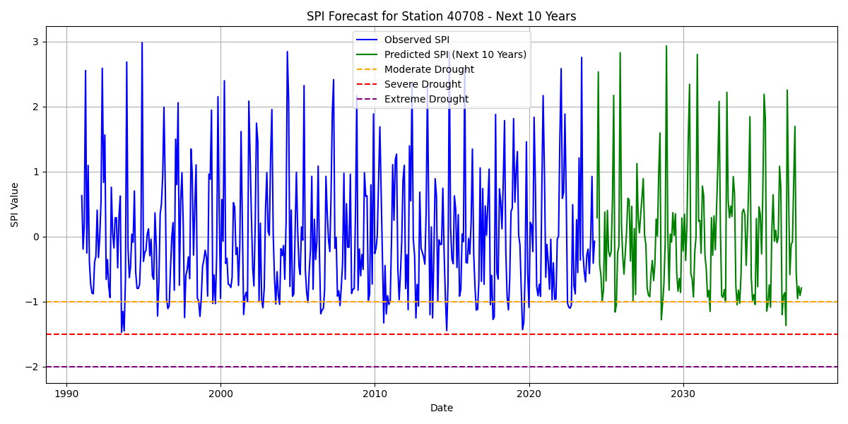
Model Comparison for SPI Prediction

Slide 21
Model Comparison for SPI Prediction
Among the tested approaches, Bi-LSTM, WBi-LSTM, and WBRF demonstrate strong predictive capability with close alignment to the actual SPI trends. In contrast, models like SVR and EDT show noticeable deviations, especially during rapid fluctuations. This comparison underscores the superior performance of advanced deep learning and ensemble models in capturing complex temporal dependencies in climatic data.

Slide 22
Taylor Diagram
It assesses machine learning and statistical models—including LSTM, SVR, MLP, EDT, RF, BRF, and Bi-LSTM—by representing three critical metrics:
the correlation coefficient,
the root-mean-square (RMS) difference
the standard deviation.
The most effective model based on its proximity to the observed data, with Bi-LSTM emerging as the top performer in this case.

Slide 23
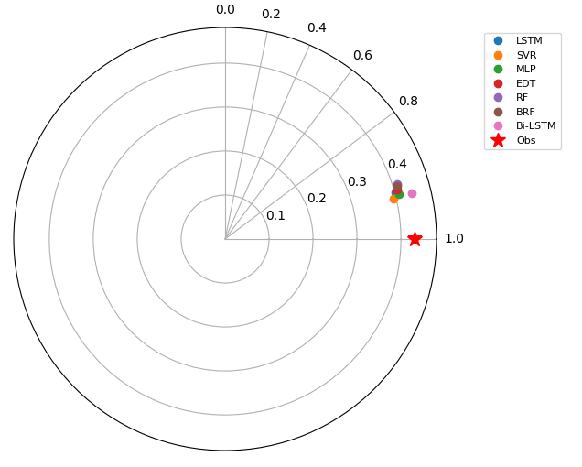
Taylor Diagram
Model Comparison
Bi-LSTM: Closest to Obs (high correlation ~1.0, standard deviation ~0.4) – best performer.
LSTM, SVR, MLP: Lower correlations (~0.2–0.3), moderate variability (~0.3).
EDT, RF, BRF: Poorest performance (correlations ~0.2–0.3, standard deviations ~0.2–0.4).

